Slide 1

PIZZA HUT PROJECT
BY Shreyash shrikrushna Kale

Slide 2

Hello
My Name is Shreyash Shrikrushna Kale, In This project I have utilized SQL queries to solve a question that Where related to pizzas Sale.

Slide 3
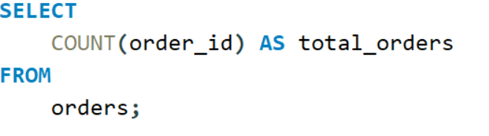
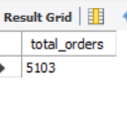
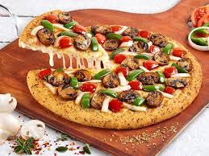
Retrieve the total number of orders placed

Slide 4
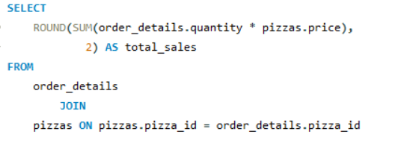
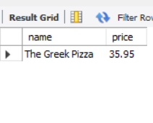
Calculate the total revenue generated from pizza sales.

Slide 5
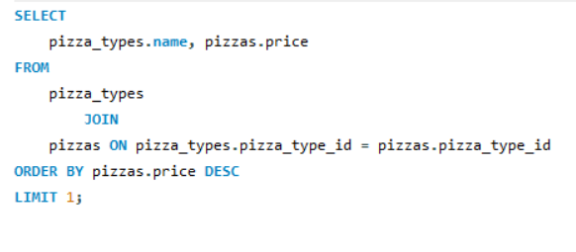
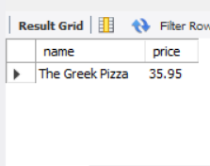
Identify the highest priced pizza

Slide 6
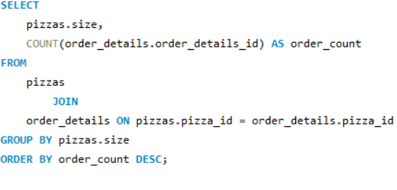
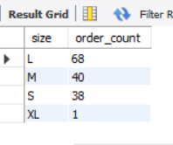
Identify the most common pizza size ordered

Slide 7
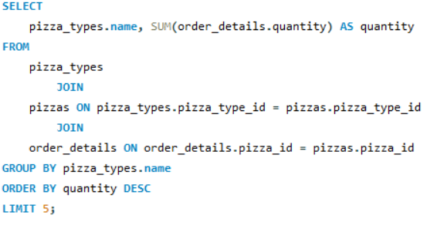
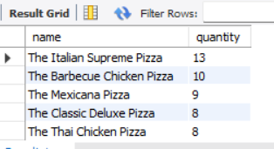
List the top 5 most ordered pizza types along with their quantities

Slide 8
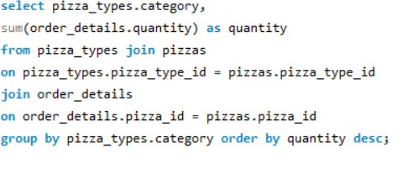
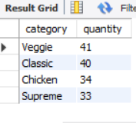
Join the necessary tables to find the total quantity of each pizza category ordered

Slide 9

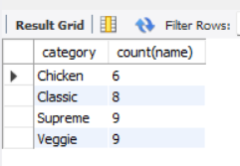
-- Join relevant tables to find category-wise distribution of pizzas

Slide 10
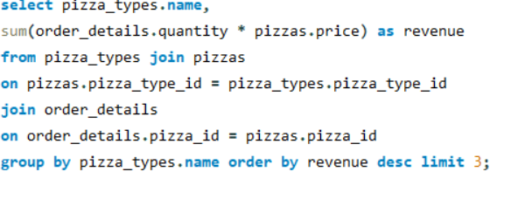
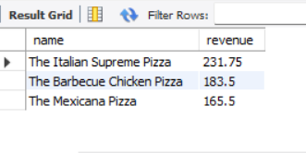
Determine the top 3 most ordered pizza types based on revenue

Slide 11
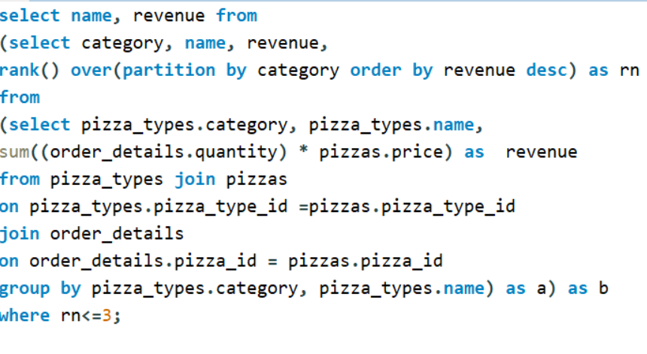
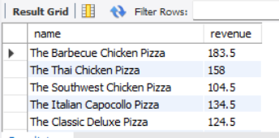
Determine the top 3 most ordered pizza types based on revenue for each pizza

